Slide 1
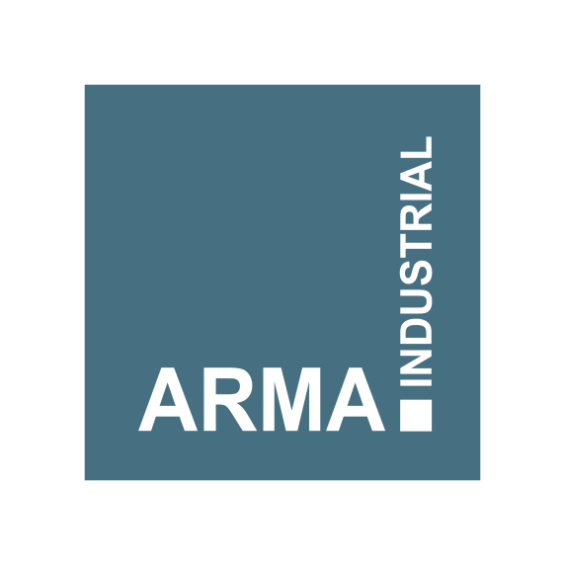
Arma Industrial Group
Commercial introduction

Slide 2
Our origin and outlook
Plant description | year | Qty. (ton/yr) | status
First hot-rolling plant | 2010 | 4,000 | Active
Second hot-rolling plant | 2013 | 10,000 | Sold out in 2014
Third hot-rolling plant | 2016 | 25,000 | Active
Rodman trading company | 2017 | --- | Active
Joint venture with continues casting plant | 2017 | 40,000 | Active
Chrome plating bars plant | 2018 | 1,000 | Active
Chrome plating bars development plan | 2019 | 2,000 | Under construction
Fifth hot-rolling plant | 2019 | 60,000 | Under construction
Billet production line (CCM) and hot-rolling plant | 2021 | 150,000 | Feasibility study stage

Slide 3
Our cash flow diagram
Commercial sales added
Rodman commercial activities started
Production sales

Slide 4
Our products
Rolled Forge (25 to 80mm)
Forged (90 to 150mm)
Tol standard: DSTU 8538
Material:
70Cr2, 1060 …
Hardness (HRC)
Sur. 58-62
Vol. 57-62

Slide 5
Our products
Hot Rolled (25 to 125mm)
Tol. standard:
DIN EN 10060
DIN1013
Material:
70Cr2, 41Cr4,
1060, 1070,
42CrMo4,
40Mn4 …
Hardness (HRC)
30±1

Slide 6
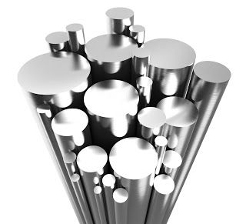
Our products
Chrome coated bars
(6 to 100mm)
Tol. standard:
ISO F7
Material:
CK45
Bar dia. (mm) | Hardness Brinell
6-16 | 218-319
16-40 | 200-298
4-100 | 172-242

Slide 7
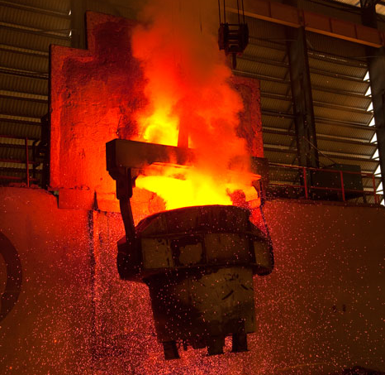
Our products
Billet sizes: 60x60,
80x80,
100x100,
125x125,
150x150,
200x200
Length up on order (4, 6 …)
Material:
3SP, 4SP, 5SP,
ST37, ST52,
CK45, 70cR2,
1060 …

Slide 8
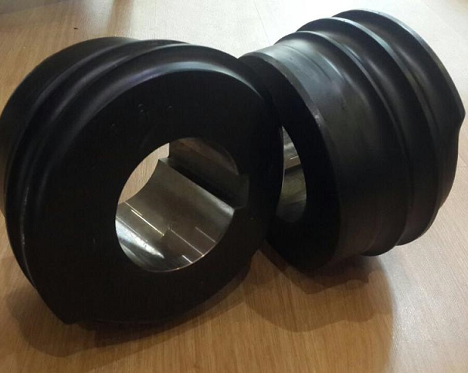
Our products
Standard: based on customer requirements
Material:
X40CrMoV5-1
Size:
ZQ20, ZQ30,
ZQ40, ZQ60,
ZQ80, ZQ100,
ZQ120
Lifetime:
For 700,000
pieces

Slide 9
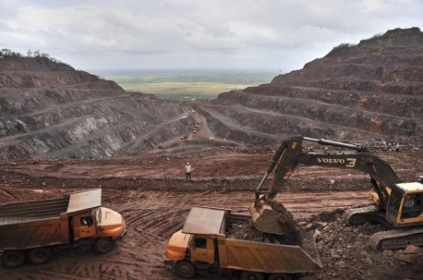
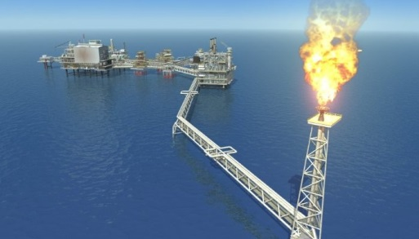
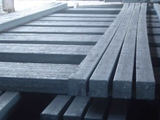
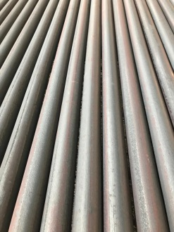
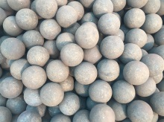
Steel products supply chain
Value chain of steel products main factors
+
=
Iron ore extraction
Plus energy consumption
Leads to steel products
Grinding ball data | Qty. (ton/year)
Iran total production capacity | 270,000
Iran total demand | 200,000
export capacity | 70,000

Slide 10
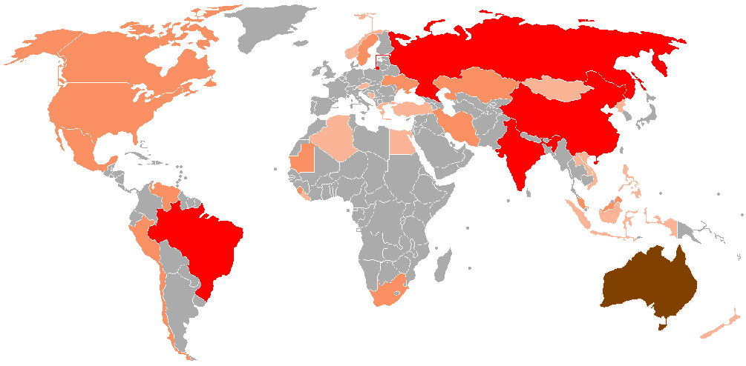
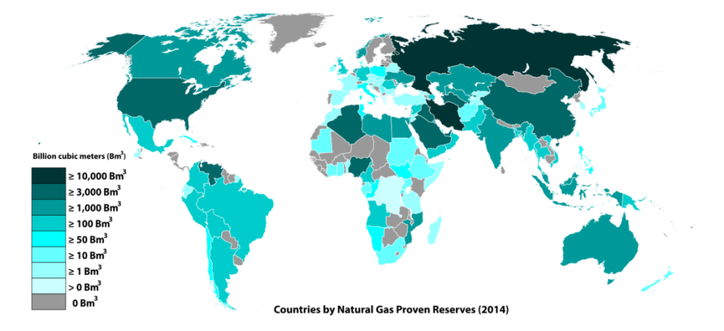
Our competitive advantages
World map of energy and mine
#2
In sponge iron production
#1
In natural gas production
Countries by iron ore production
Countries by natural gas production
This situation puts Iran in a prominent position in the trade of steel products in the world.

